Slide 1
Gym Member Manager Internal Guide :Dr. K.Ram Mohan Rao
By
P. Sai Venunath 1602-16-737-038
K.Rohith 1602-17-737-030
Team-1

Slide 2
Contents
Purpose
Modules
Technology Stack
Outputs
Future Scope
References

Slide 3
Purpose
Many gyms are following manual process which is hectic less accurate and time consuming
This project is to facilitate a local gymming and fitness center to automate its operations of keeping records of members

Slide 4
Modules
Login
Home Page
Join Page
Members
Remainders
Monthly Analysis

Slide 5
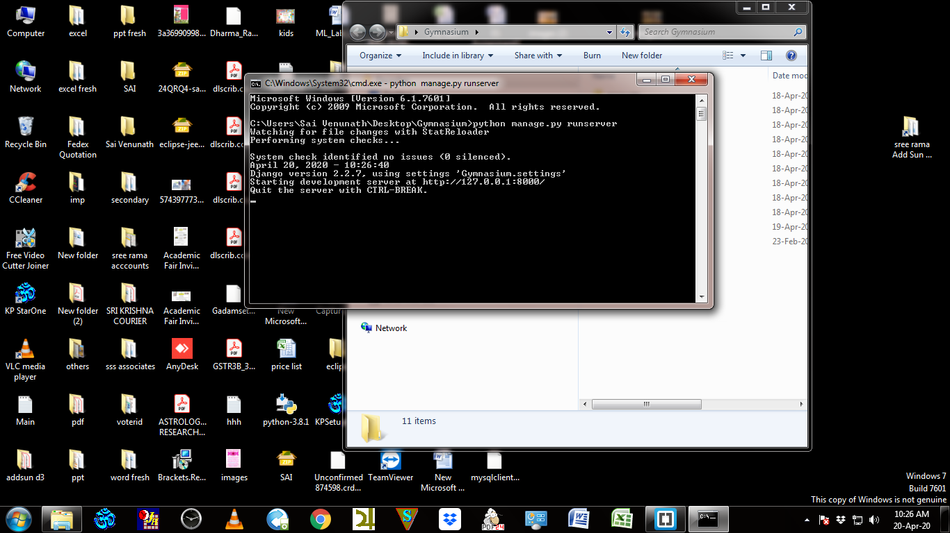

Slide 6
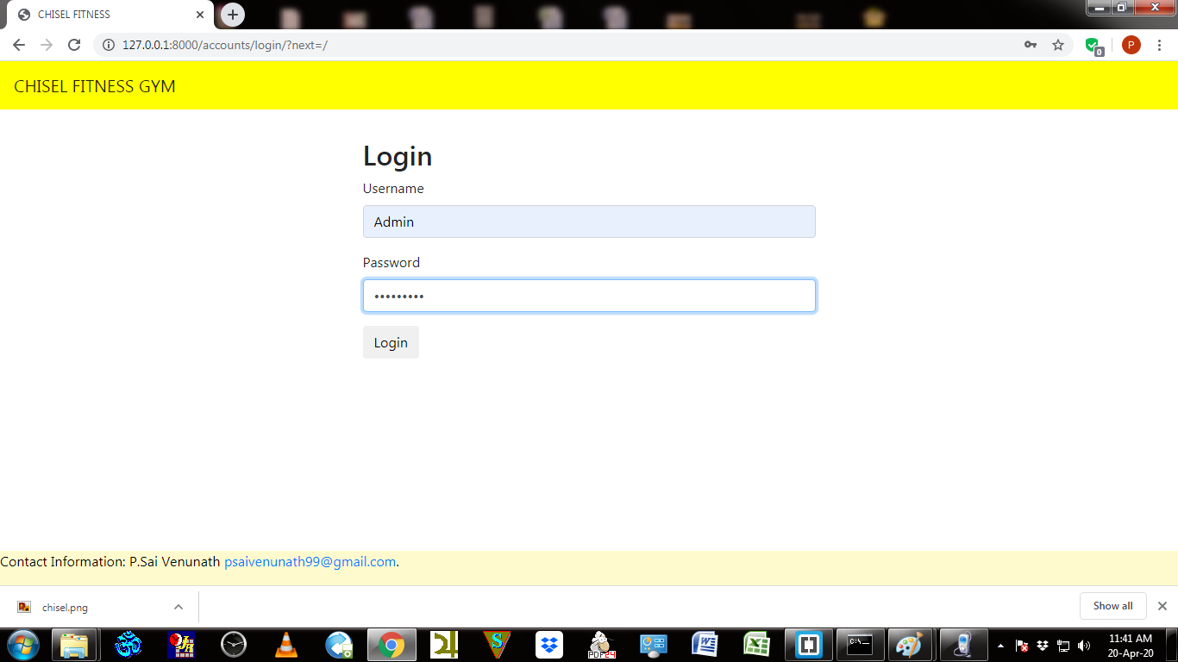

Slide 7
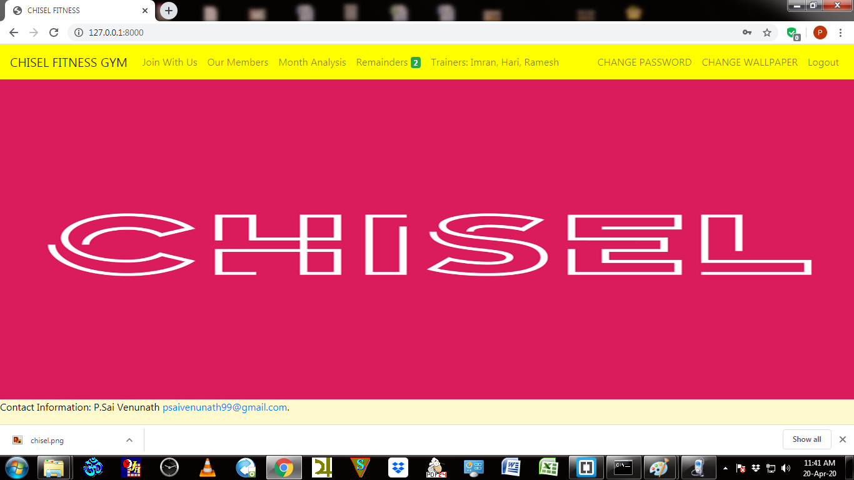

Slide 8
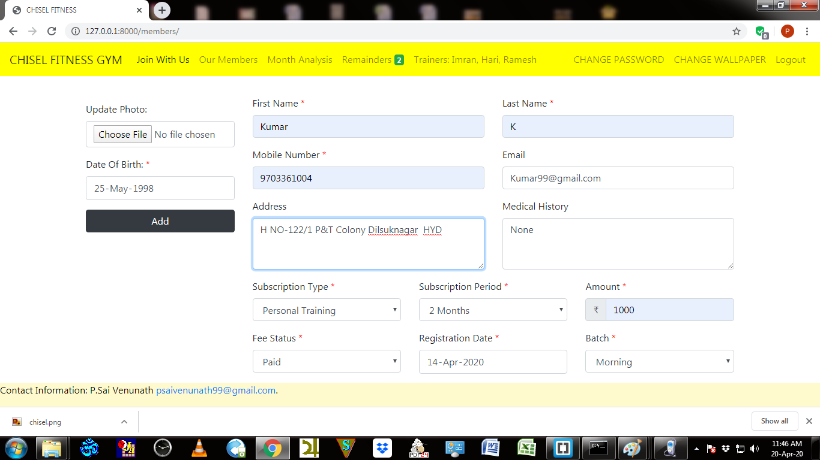

Slide 9
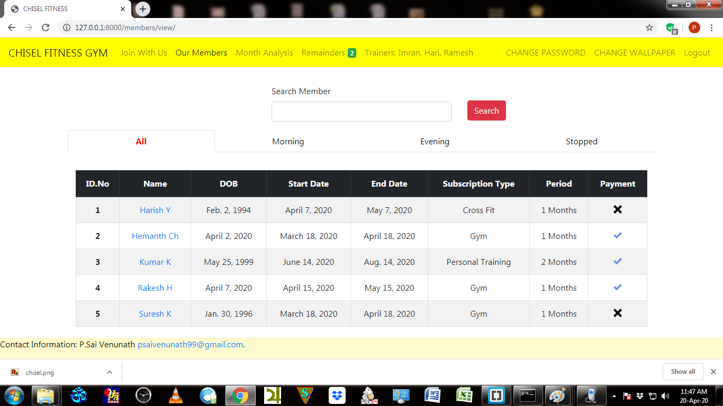

Slide 10
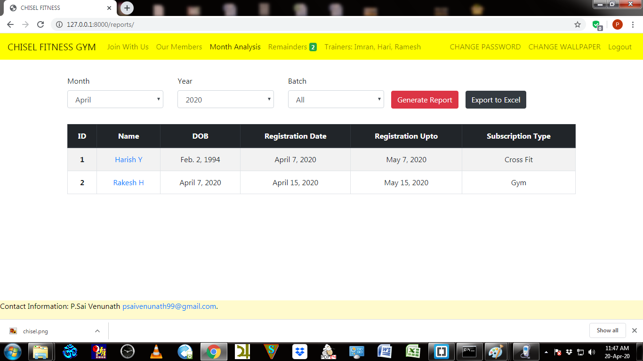

Slide 11
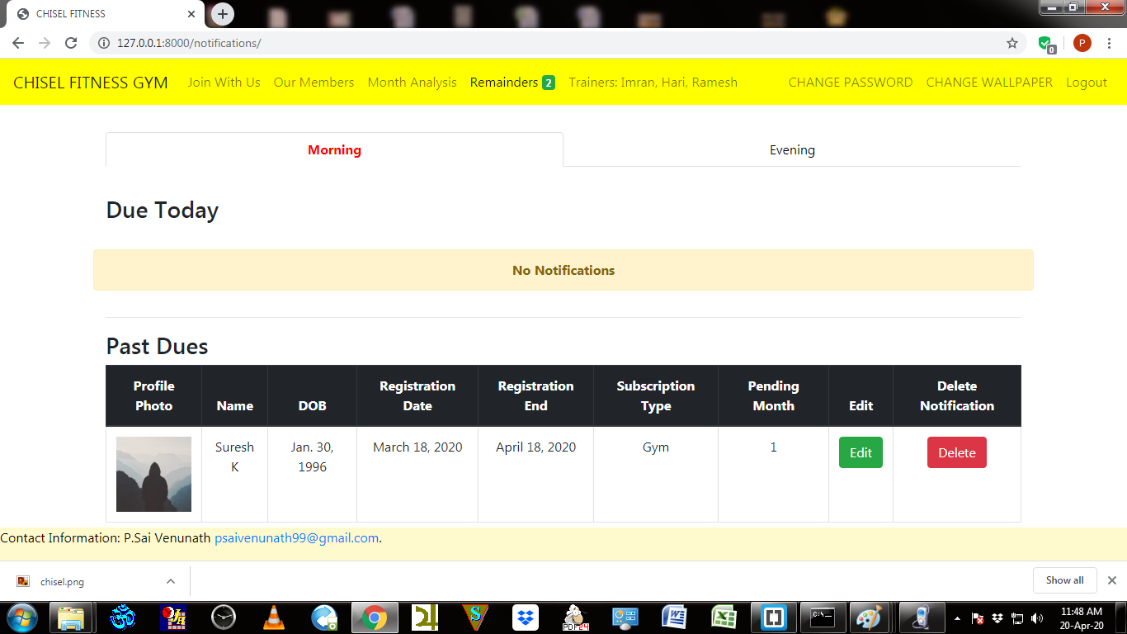

Slide 12
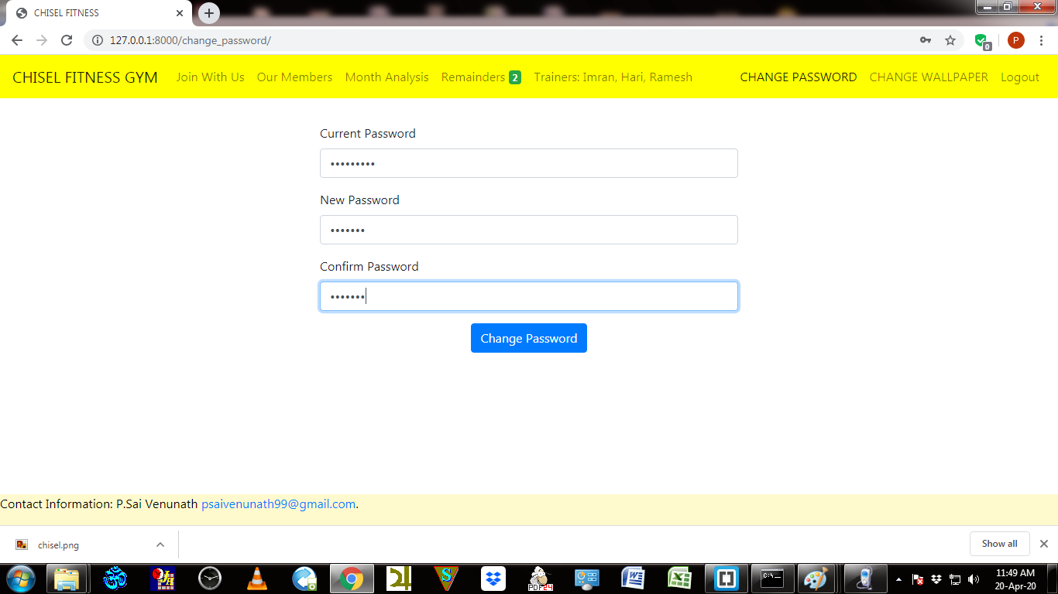

Slide 13
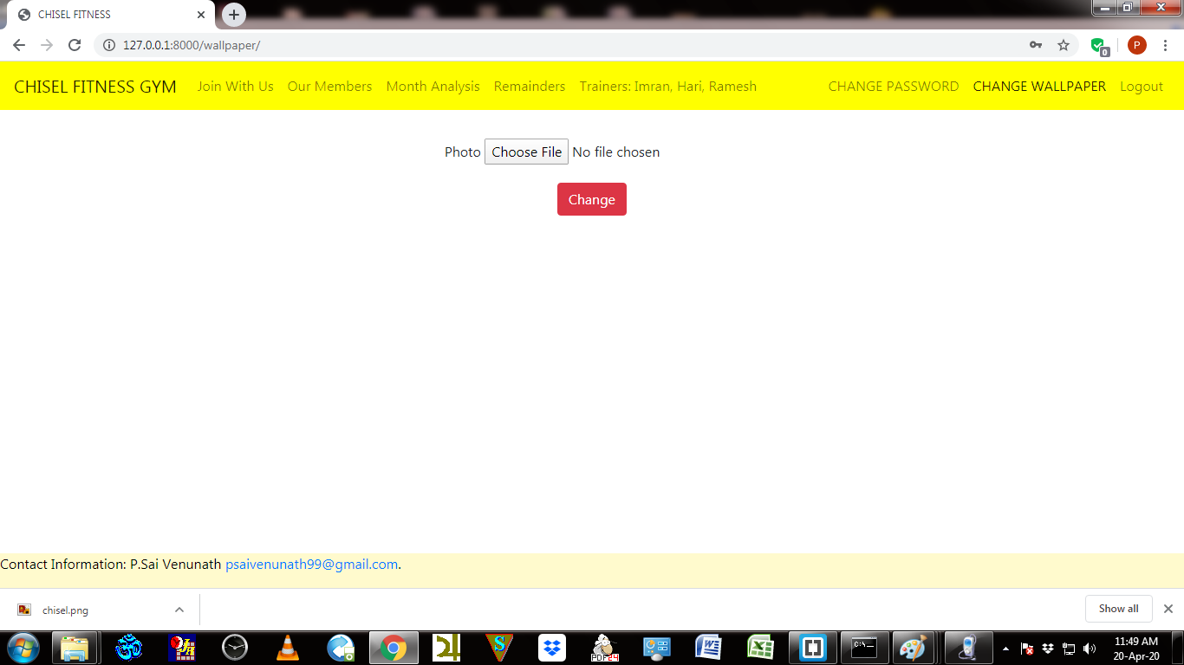

Slide 14
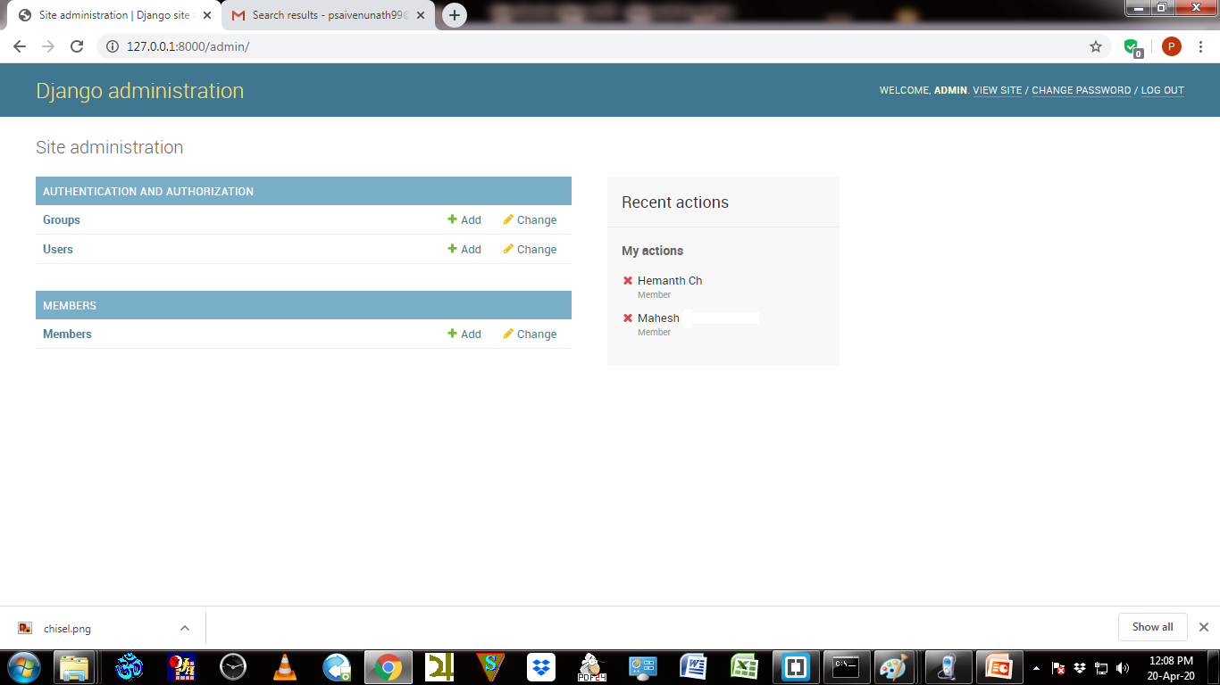

Slide 15
Future Scope
→ Notifications Of Fee Payment can be send to the customers mobile number a day before the deadline.
→Health care Chatbot can be introduced in the website so that customers can clarify their issues on fitness.

Slide 16
References
https://www.udemy.com/course/projects-in-django-learn-django-building-projects/
https://docs.djangoproject.com/en/3.0/ref/contrib/admin/
https://getbootstrap.com/docs/4.0/components/navbar/
https://www.w3schools.com/js/

